Slide 1

JSON Data
Demo

Slide 2
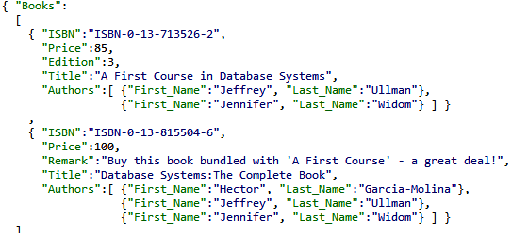
JSON Demo
JavaScript Object Notation (JSON)
Standard for “serializing” data objects in
human-readable format
Useful for data interchange, and for representing
& storing semistructured data

Slide 3
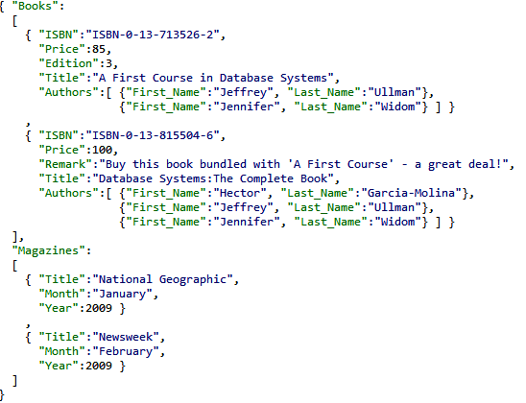
JSON Demo
Basic constructs
(recursive)
Base values
number, string, boolean, …
Objects { }
sets of label-value pairs
Arrays [ ]
lists of values

Slide 4
JSON Demo
Demo
Constructs and syntactic correctness
Flexibility
JSON Schema, validation

